Slide 1
Library@ K J Somaiya Institute of Management
Objective- To be the preferred source of information and learning in management for all Students and Facilitators

Slide 2
Glimpses of Library

Slide 3
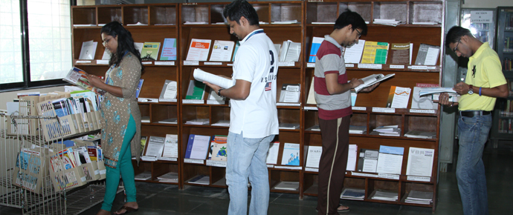
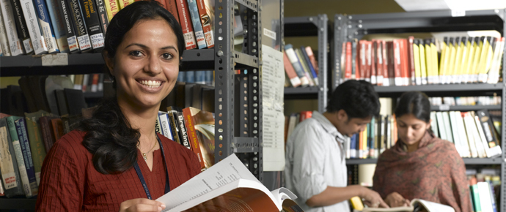
Glimpses of Library

Slide 4
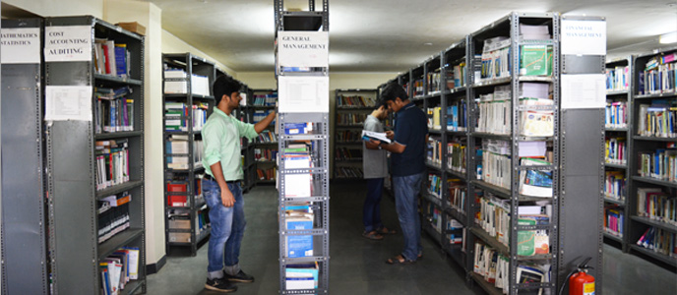
Glimpses of Library

Slide 5
Online Databases @ K J SIM
Sr. | Database Name | Link & details
01 | EBSCO Business Source Complete | EBSCO includes full text Journals, case studies, company profile, Industry reports http://search.epnet.com
02 | EUROMONITOR | Euromonitor is having primary reports of market shares, industry news, brand shares forecast for over 100 countries..... http://portal.euromonitor.com
03 | ACE-Equity | ACE Analyser is a web based database, which tracks all listed / unlisted companies’ details, their performance like Quarterly results, Corporate events, Trading details and Annual reports information for research and analytical purposes. http://www.aceanalyser.com
04 | PROQUEST | Full text Journals, Case studies, conference proceedings, research papers http://search.proquest.com

Slide 6
Online Databases @ K J SIM
Sr. | Database Name | Link & details
05 | PROWESS CMIE | Prowess is a database of the financial performance of Indian companies. Annual Reports of individual companies is the principal source of this database. The database covers listed and unlisted companies. https://prowessiq.cmie.com
06 | EMERALD | Full text access of International Management Journals http://www.emeraldinsight.com
07 | CapLine – Capital Market | Financial database contain financial information on Indian company used for research purpose. http://www.capitaline.com https://awsone.capitaline.com/Externel-Access-IpLogin.html (For registration)
08 | IEEE | Publish journals, conference publication and e-books related to computer and it http://ieeexplore.ieee.org

Slide 7
Online Databases @ K J SIM
Sr. | Database Name | Link & details
09 | J-Gate | J-Gate provides seamless access to millions of journal articles available online offered by Publishers. It presently has a massive database of journal literature, indexed for e-journals with links to full text at publisher sites. http://www.jgateplus.com
10 | WARC | Provides cases and articles related to marketing, advertising and communication http://www.warc.com
11 | NAV India Software | Software use to get information about mutual fund. www.navindia.com
12 | Emerald – Case Collection | Case collection of Emerald Publishers http://www.emeraldinsight.com

Slide 8
Online Databases @ K J SIM
Sr. | Database Name | Link & Details
13 | EMIS | EMIS provides information on emerging markets. Covering over 125 developing countries, our information platform provides a unique blend of analysis, data and news on companies, industries and countries. https://site.securities.com/emis
14 | EPW Research Foundation | EPWRF has built up expertise in important areas of economic research and analysis. The Foundation has been focusing on a systematic compilation and dissemination of current and long-term data series on the macro-economy, as also various economic, social and demographic sectors. http://www.epwrfits.in
15 | Sage Research Methods | SRM Supports research at all levels by providing materials to guide users through every step of the research process. http://methods.sagepub.com

Slide 9
Online Databases @ K J SIM
Sr. | Database Name | Link & Details
16 | CMIE 1.Consumption pyramid 2. Aspirational India 3. Income Pyramids 4. People of India | Consumer Pyramids Household Survey (CPHS or CPDx): It is a raw record-level time-series data from the world's largest household panel survey. This offers data of over 232,000 households and 1.19 million individuals surveyed since 2014. https://peopleofindiadx.cmie.com/ https://aspirationalindiadx.cmie.com/ https://incomepyramidsdx.cmie.com/ https://consumptionpyramidsdx.cmie.com/
17 | Taylor and Francis | Taylor and Francis is the e-journal content platform gives online access to business management collection ejournals published by Taylor & Francis , with a powerful search that makes it simple to discover the most relevant research for readers https://www.tandfonline.com
18 | Epigeum and Avoiding Plaigarism (oxford) | Epigeum is concise but comprehensive online course on how to avoid plagiarism, covering the use of citations and references, accurate paraphrasing, and good study habits. https://plagiarism.epigeum.com

Slide 10
Online Databases @ K J SIM
Sr. | Database Name | Link & details
19 | Grammarly | Grammarly is the world’s leading writing support tool for researchers www.grammarly.com/edu (Registration mandatory)
20 | NPETL | NPTEL Provides web and video courses were created in all major branches of engineering, physical sciences at the undergraduate and postgraduate levels and management courses at the postgraduate level. http://nptel.ac.in
21 | Digital Library | The National Digital Library of India (NDLI) is developed by IIT Kharagpur, holding collection of huge eBooks. https://ndl.iitkgp.ac.in
22 | Web of Science | The Web of Science™ is the world’s most trusted publisher-independent global citation database. its multidisciplinary platform connects regional, specialty, data and patent indexes to the Web of Science Core Collection http://webofscience.com

Slide 11
Online Databases @ K J SIM
Sr. | Database Name | Link & details
23 | Scopus | Scopus uniquely combines a comprehensive, expertly curated abstract and citation database with enriched data and linked scholarly literature across a wide variety of disciplines. http://www.scopus.com
24 | Marketline | MarketLine' database is a record of global information on mergers and acquisitions (M&A); private equity, venture finance, private placement and industry profile. https://advantage.marketline.com/HomePage/Index?returnUrl=Home
25 | CEIC | Macroeconomic time series covering data from primary sources as well as multilateral agencies. http://insights.ceicdata.com
26 | Statista | Statista is the global business data platform that provides market and consumer data from industries, countries and regions. https://www.statista.com/

Slide 12
Online Databases @ K J SIM
Sr. | Database Name | Link & details
27 | Sage Business Cases | SAGE Business Cases cover cases the areas like Public Policy, Information Technology related cases, Global Marketing, Venture Capital etc. https://sk.sagepub.com/cases/discipline
28 | Sage eJournals | SAGE Business journals are available of management and organization studies https://journals.sagepub.com
29 | Oxford eJournals | Oxford USINESS MANAGEMENT & ECONOMICS & FINANCE COLLECTION eJournals available https://academic.oup.com/jcr
30 | Wiley eJournals | Wiley Management eJournals https://onlinelibrary.wiley.com
31 | IndiaStat | Socio economic statistical information about India www.Indiastat.com
32 | Edzter | E-newspapers and eMagazines – Continue with email address for verification https://www.edzter.com/login

Slide 13
e-Books
Sr. | Name | URL for Database / Website
01 | EMERALD : E –Books | Collection management eBooks of the year 2016-17.. http://www.emeraldinsight.com
02 | EBSCO : E-Books Business Collection | Collection of Business Management eBooks. . http://search.epnet.com
03 | Taylor & Francis e-Books | Taylor and Francis management collection. https://www.taylorfrancis.com
04 | Proquest E-Books | Proquest Business Management and Social Science collection. http://search.proquest.com

Slide 14
Library Facilities
Online catalogue to search books
http:// opac.somaiya.edu
RFID identity card and bar-coded books enable fast issue and return of books

Slide 15
Library Policies
Books for issue - 10 books at a time per student.
Period for renewal/deposit of Books–14 days*
Fine for Overdue Books : Rs 10 per day per book
Journals, Magazines, Reference Books and Newspapers not for Issue home issue.
*In case the book is not demanded by any other user, student can keep the book for entire One year - The book will get auto renewed in the system. However, if the book is demanded by any other user and there is no copy available in the Library, the student has to submit the book in the running 14 day cycle.

Slide 16
Library Fine - Policy
As per credit policy students can accumulate fine up to Rs. 1000 /-.
After the fine reaches Rs. 1000 /- student’s account automatically gets blocked
The account gets activated only when the student pay the fine to the accounts department and informs the librarian.
If student’s fine doesn’t exceed rupees 1000 /- then the amount is deducted from students caution money.

Slide 17
Renewal of Books
There are two ways by which students can renew their books.
1. Manual : Bring books to library.
2. Online : Renew books online through SVV username and password given by college.
http:// opac.somaiya.edu – Libraries – Somaiya Vidyavihar Online Library Search – My Account
Use your SVV net Id and Password

Slide 18
Global common circulation policy
As per Global Common circulation policy, faculty, students and staff can issue one book from any other college / institute of Somaiya group using member identity card.
GCC policy for SVV Campus & Ayurvihar campus libraries as under:
Member may pay late fine in Library-counter itself or in office Cash-Counter. This depends on Library configuration.
In case Member fails to return in time, reminder email will be sent. And his/her local issue will be LOCKED. Once book returned and calculated GCC late fine paid by member, then account will be UN-LOCKED.

Slide 19
LIBRARY TIMINGS
The library remains open on all the working days except holidays as notified by institute.
Monday to Saturday : 10:00 a.m. to 8:00 p.m.
Sunday : 10:00 a.m. to 5:00 p.m.
Lunch Break : 1.30 p.m. to 2.00 p.m.

Slide 20
How to access E-Resources
To access e-Journals within campus, use below link
http://search.epnet.com & respective links given for the database
To access e-Journals out of campus , use below link
https://library.somaiya.edu - Please use your email credentials / login and password to access e-journals and databases.- After login Scroll Down, Click on List view under Database, Click on Name of Database)
About Library | KJ SIMSR (somaiya.edu) : https://simsr.somaiya.edu/en/about-library

Slide 21
Thank You
Librarian- Mr. Rajesh Memane
rajeshmemane@somaiya.edu / librarian.simsr@somaiya.edu
simsr.Somaiya.edu

